Slide 1
Reading Recovery Follow-up Study
Cohort 4 Survey Questions

Slide 3
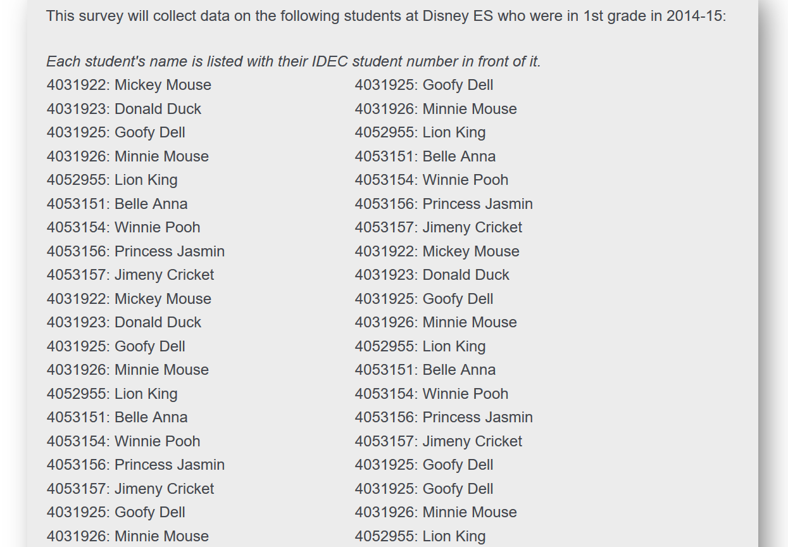

Slide 4
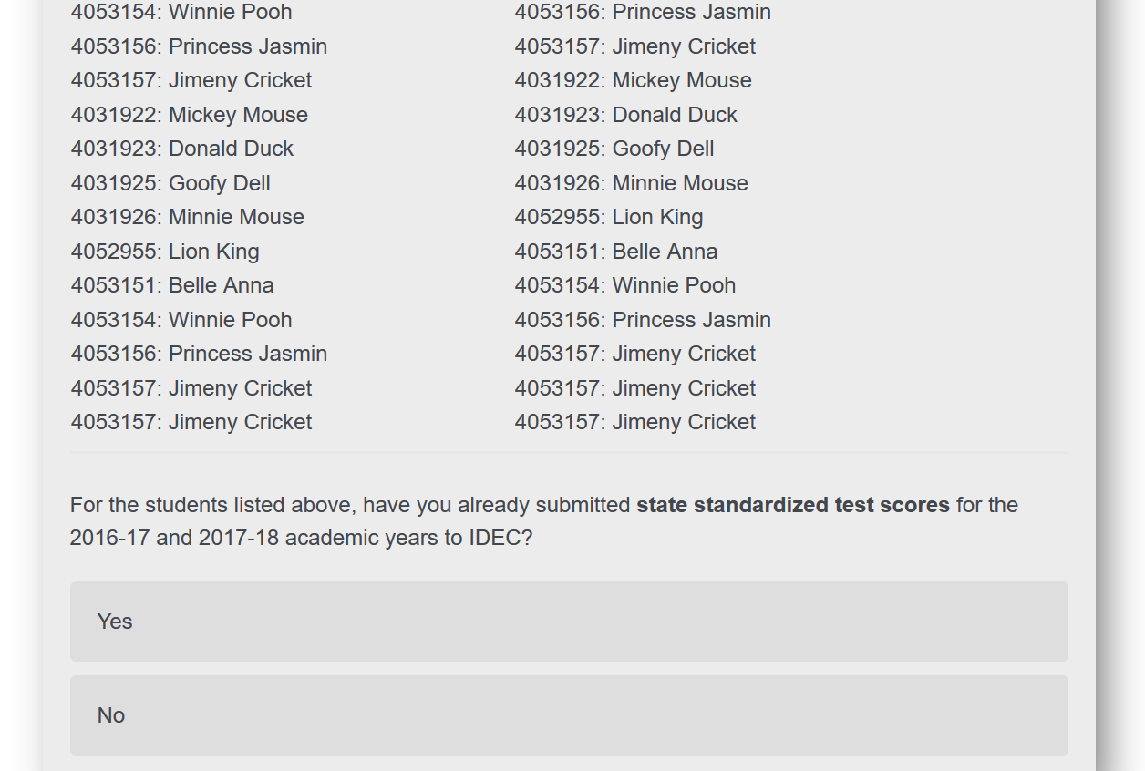

Slide 6
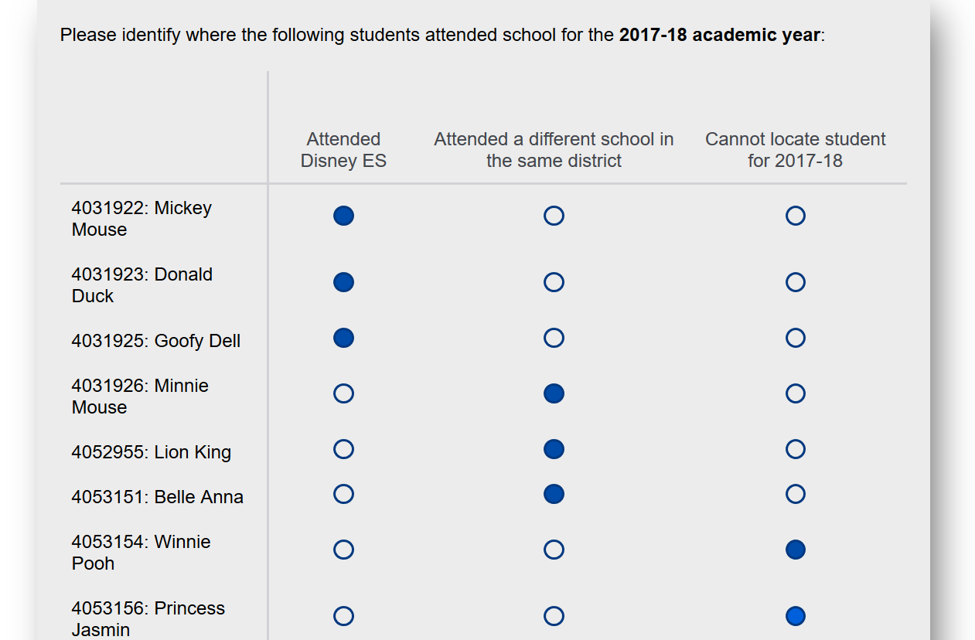

Slide 7
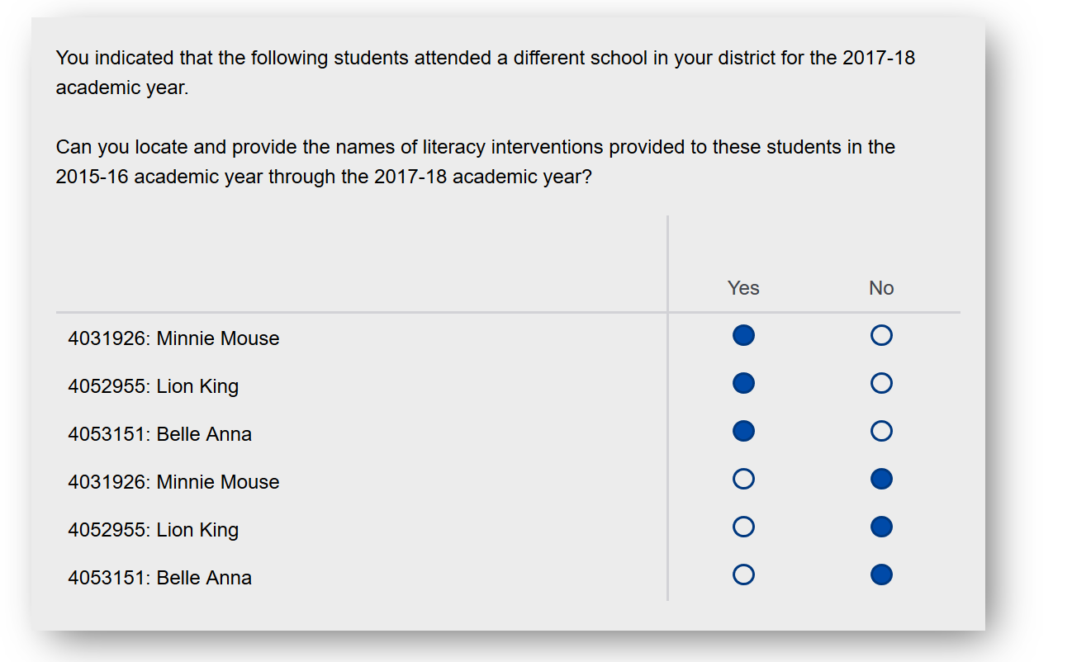

Slide 12
